Slide 1
Looking at how Covid-19 has impacted on people’s financial planning and discussing how good financial planning can help you weather the storm.
By Vintage Financial Planning

Slide 2
Impact of Covid-19
Reduced Incomes?- Furlough/ Lockdowns
Increased Debts- Bounceback Loans, Personal Debts.
Mortgage ‘‘Holidays’’?
Pushed back Financial Goals?
Increased Illness- Mental Health/ Long Covid
All these have created mass uncertainly for many people both on personal and business level.

Slide 3
Wellness

Slide 4
Stepping stones

Slide 5
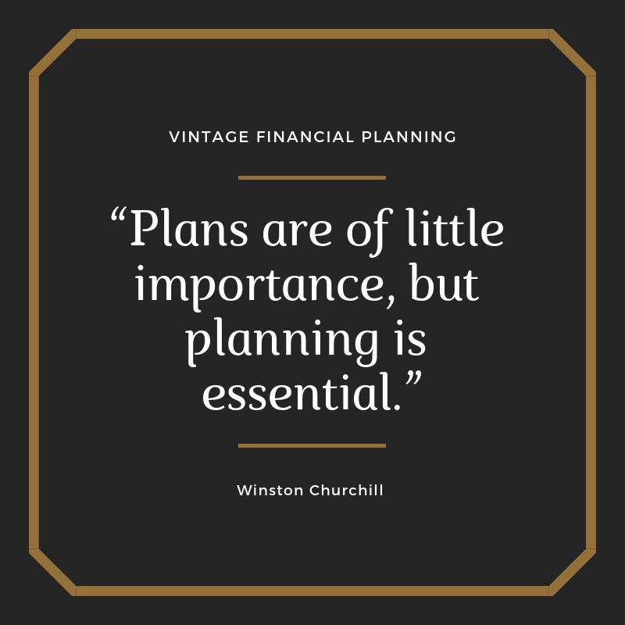
Good Financial Planning
Money Management- Income/ Outgoings- Emergency fund in place
Debt Management- Ongoing reviews of mortgages- consolidation
Protection Plans- Life & Income
Estate Planning- Wills & LPA’s
Retirement Planning/ Long Term Investing
One Stop Shop!
Call us today- 01732 471070 we can help with these

Slide 6
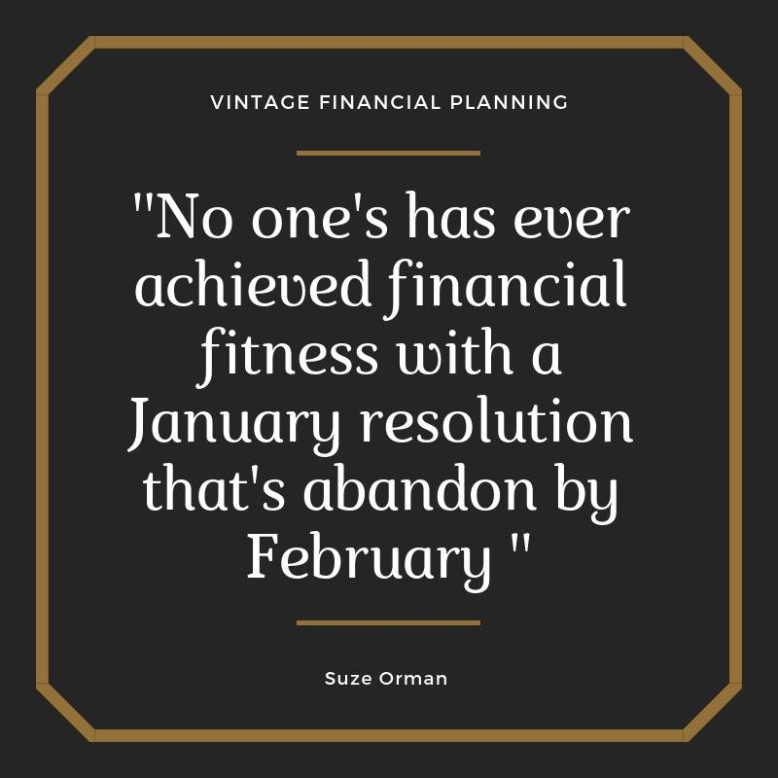
Looking forward to 2021
As you can see been a tough year but with some good and simple financial planning we can ensure you can weather any storm going forward.
We offer personal and local advice that suits your needs & goals.
If you are a business owner, director, self-employed or employee why not contact Vintage Financial Planning for a free money management session today till the end of February.

Slide 7
Contact us to find out more
Email us at: enquiries@vintagefinancialplanning.co.uk
Check out our website: www.vintagefinancialplanning.co.uk
Call us 01732471070 to find out how we at Vintage can help you today.
Follow us on:
Facebook- Vintage Financial Planning
Twitter- Vintage Financial
Linked In- Vintage Financial Planning

