Slide 1
CYBERSECURITY
A presentation by Computer Troubleshooters - 2021
Notes:
Suzanne

Slide 2
WHAT IS Cybersecurity?
Cybersecurity is the practice of protecting systems, networks, and programs from digital attacks.
These cyberattacks are usually aimed at accessing, changing, or destroying sensitive information; extorting money from users; or interrupting normal business processes.
Implementing effective cybersecurity measures is particularly challenging today because there are more devices than people, and attackers are becoming more innovative.
Notes:
Steve: What types of attacks – I'll talk about the 2 that are most common

Slide 3
WHAT IS Cybercrime?
Notes:
Suzanne

Slide 4
Notes:
Suzanne

Slide 5
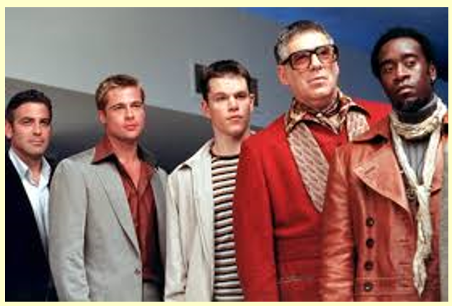
Notes:
Suzanne

Slide 6
Notes:
Suzanne

Slide 7
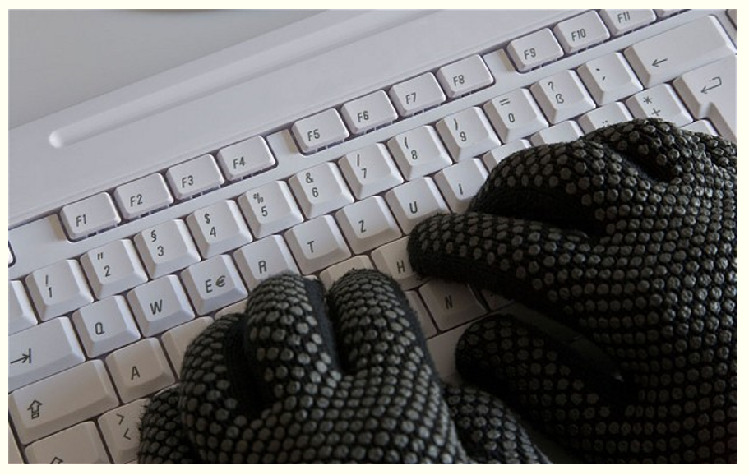
Notes:
Suzanne

Slide 8
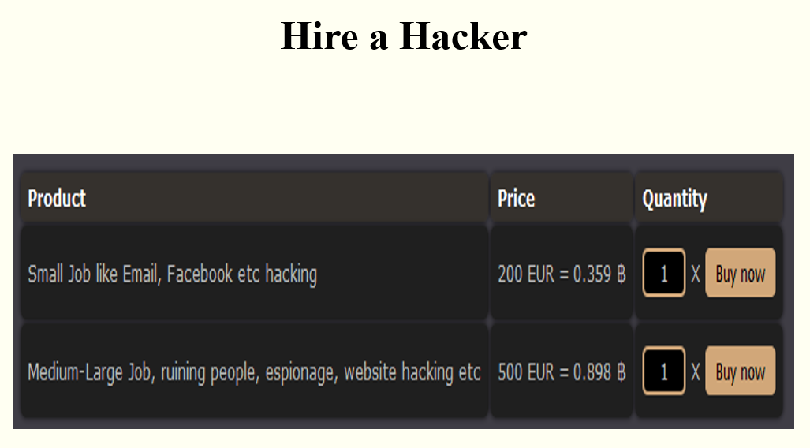
Notes:
Suzanne

Slide 9
PHISHING
Phishing is the practice of sending fraudulent emails that resemble emails from reputable sources.
Notes:
Steve: The aim is to steal sensitive data like credit card numbers and login information. It’s the most common type of cyber attack.

Slide 10
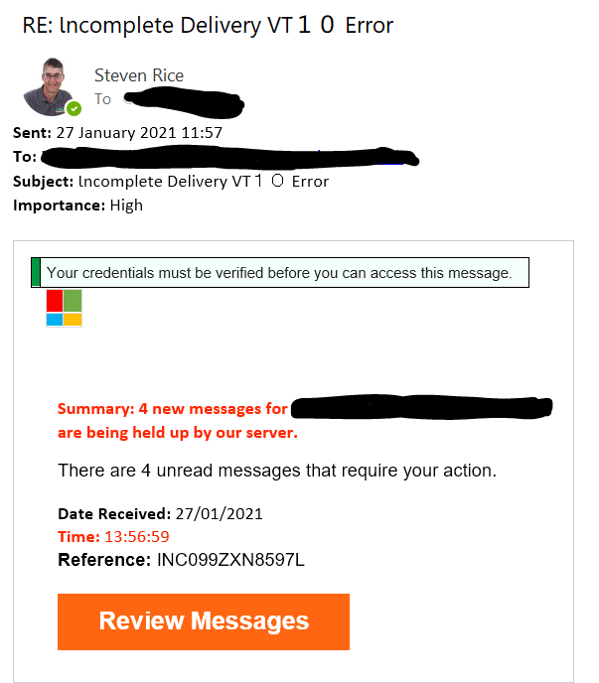
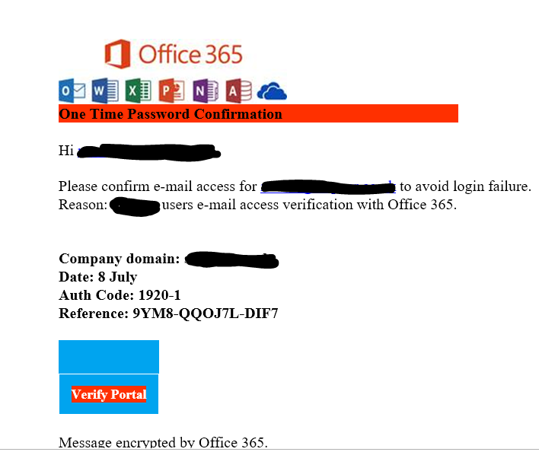
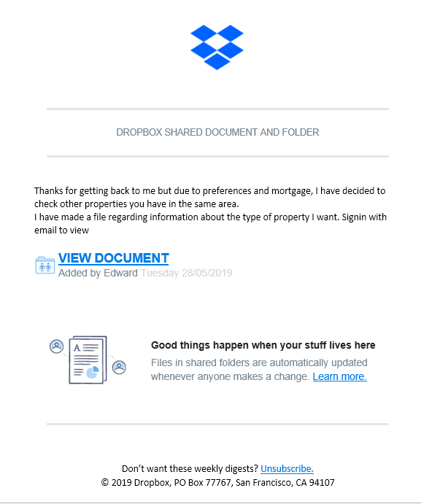
Notes:
Steve: Common theme across these example is that they are all have a call to action:
Click here to see your messages, verify email access, get this document.
Different levels of sophistication. First one only had email addresses in blacked out sections – impersonal. Second one had name of the person and also the company name.
Third one is even more targeted, sent to estate agent, from an initial query on website, is property available. Dropbox logo.

Slide 11
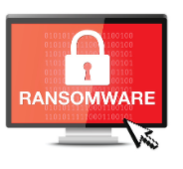
RANSOMWARE
Ransomware is a type of malicious software. It is designed to extort money by blocking access to files or the computer system until the ransom is paid.
Notes:
Steve: UK was the second most-attacked country in the world last year for ransomware attack, costing UK businesses a total of £365 million for the year.

Slide 12
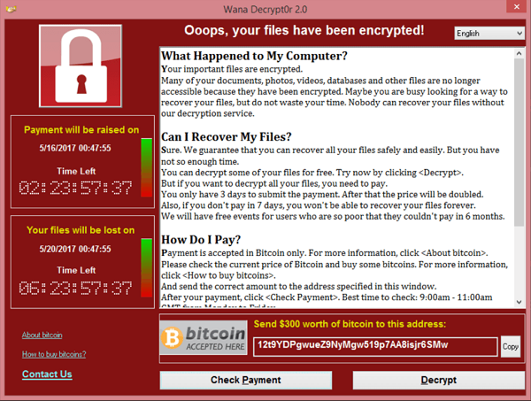
Notes:
Steve: One of the most infamous ransomware attacks – Wannacry
IN 2017 hit the NHS hard - afflicting over 200,000 computers in over 150 countries
Typical points to note : deadline, double payment, lost forever.
A step further – steal data so that if do not pay ransom, the data is made publically available on the web.

Slide 13
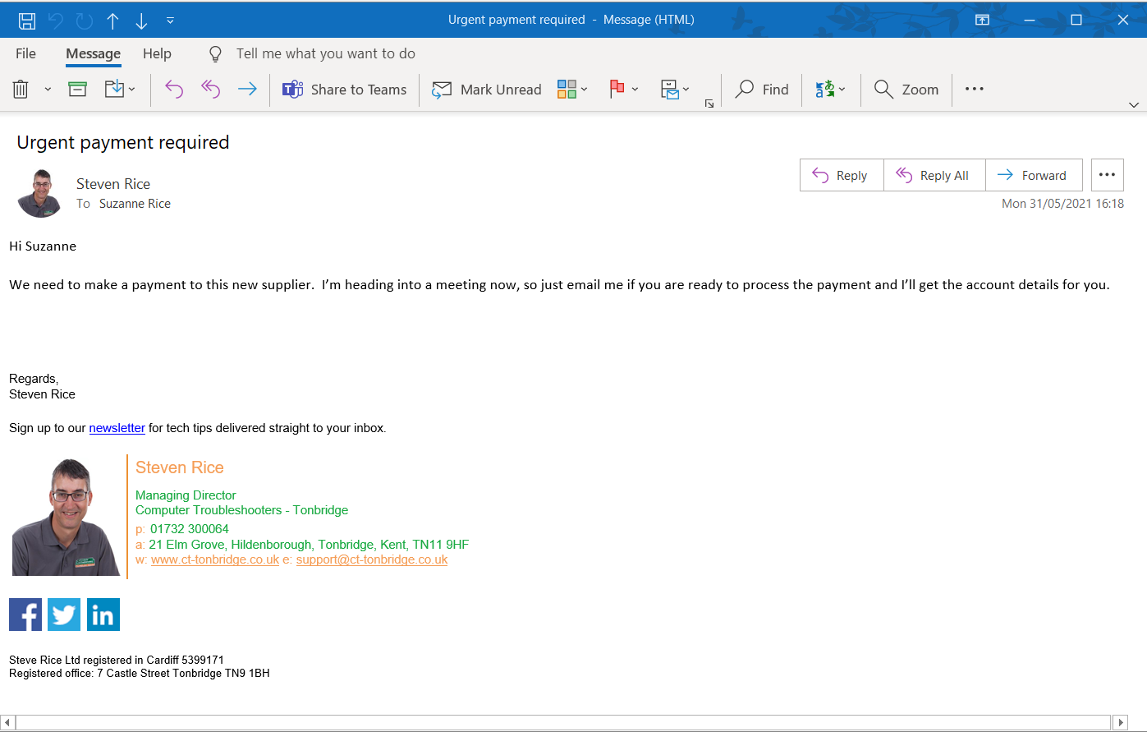
Notes:
Suzanne: CEO fraud

Slide 14
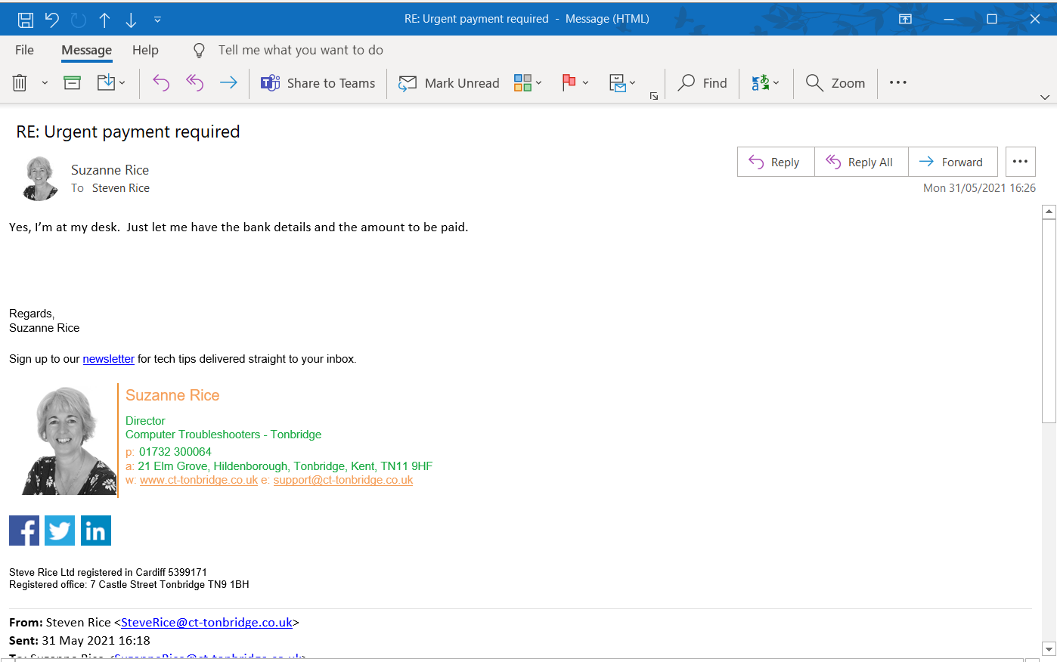
Notes:
Suzanne – CEO fraud response

Slide 15
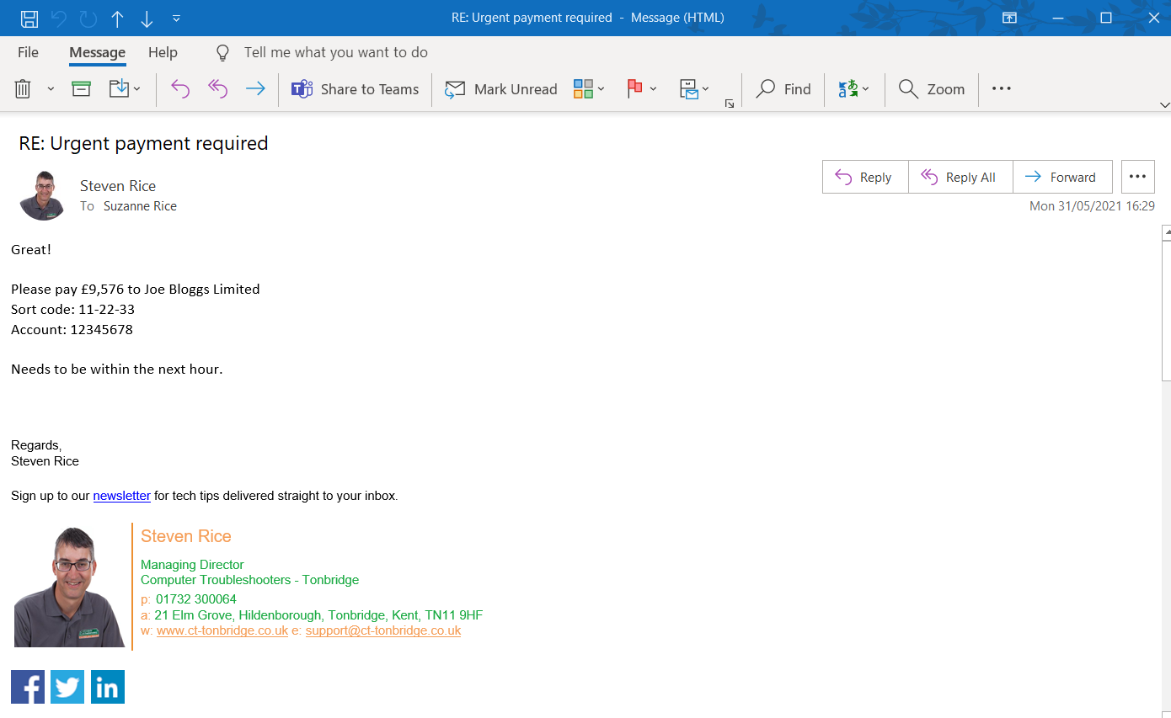
Notes:
Suzanne – CEO fraud

Slide 16
100 %
Advanced
80 %
Standard
Antivirus
Firewall
Patching
Access control
Password Management
MFA
Email Filters
Common Sense
Backup
Encryption
0 %
Notes:
Steve
Cybersecurity is about managing risk.
Advanced - SIEM

Slide 17
100 %
Advanced
80 %
New Standard
SAT (Security Awareness Training) - EDR (Endpoint Detect & Response) - Web Protection
60 %
0 %
Notes:
Steve: New standard – Waiver if clients do not want this protection.

Slide 18
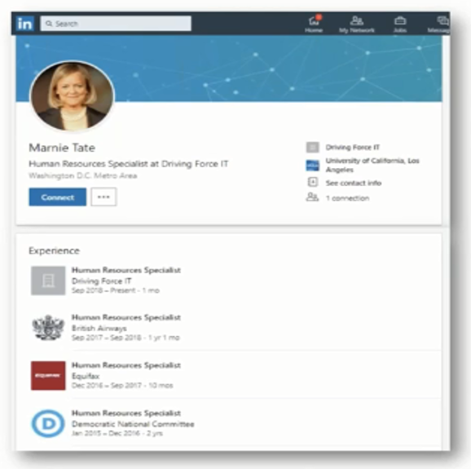
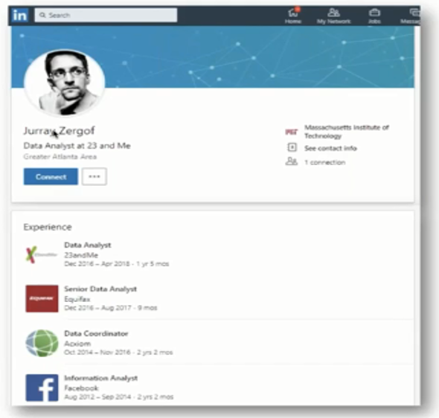
Notes:
Steve/Suzanne
How SIEM can protect you from an attack.
LinkedIn Example

Slide 19
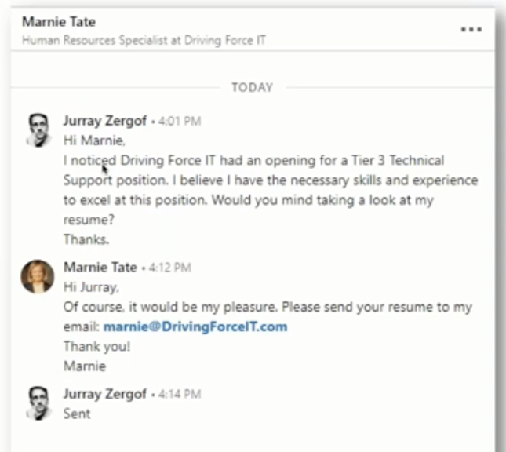
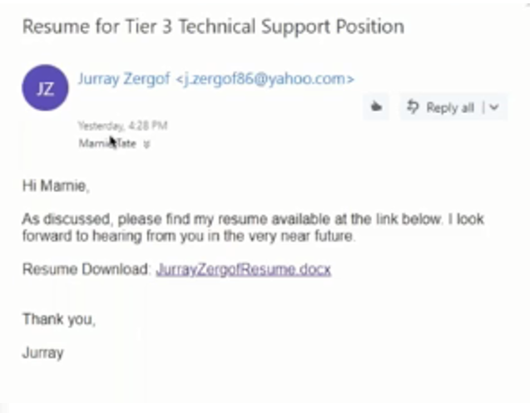
Notes:
Steve/Suzanne
LinkedIn conversation - cv sent – link doesn’t work.

Slide 20
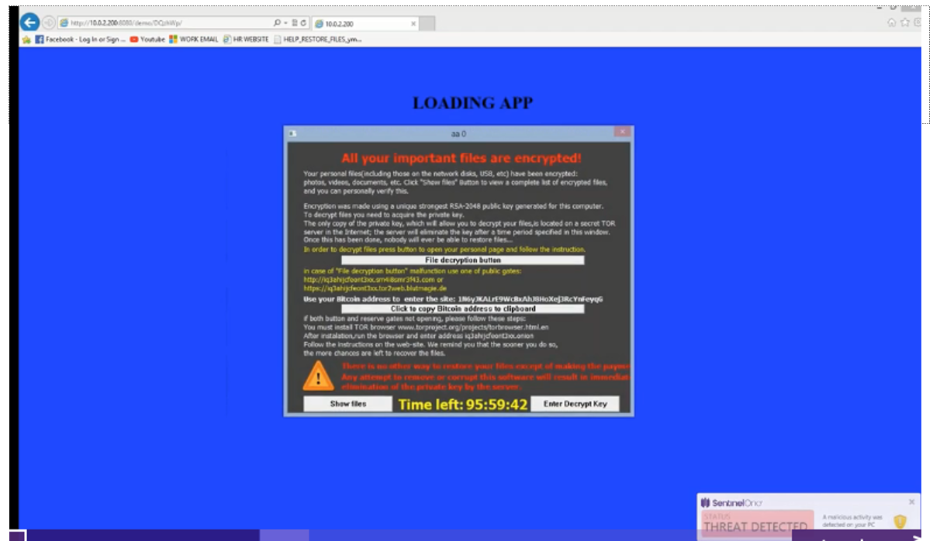
Notes:
Steve/Suzanne
Ransomware – how the SOC could have helped.

Slide 21
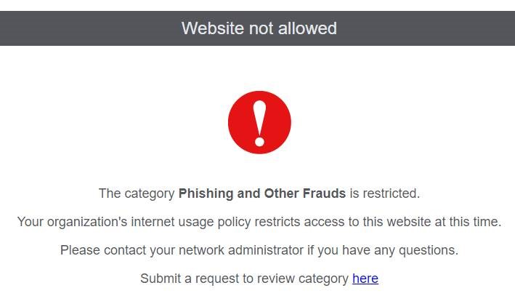
Notes:
Steve
DNS protection – Not tied to a location, on computer so doesn't matter where you are.
Can control internet usage.

Slide 22
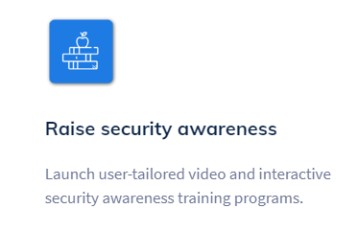
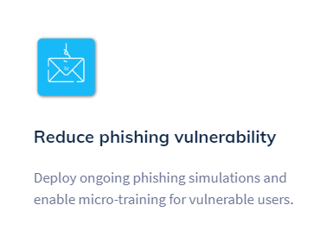
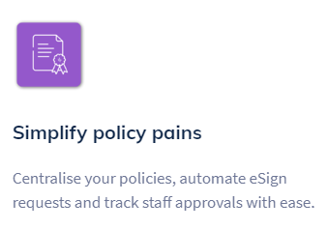
SAT (Security Awareness Training)
Notes:
Steve – Security Awareness Training – your employees are the weakest link.

Slide 23
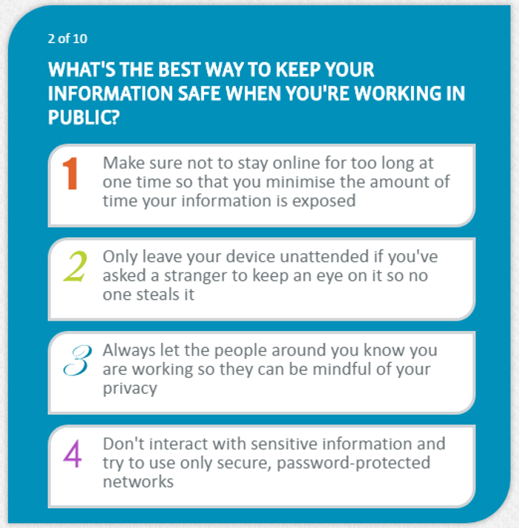
Notes:
Suzanne – SAT example

Slide 24
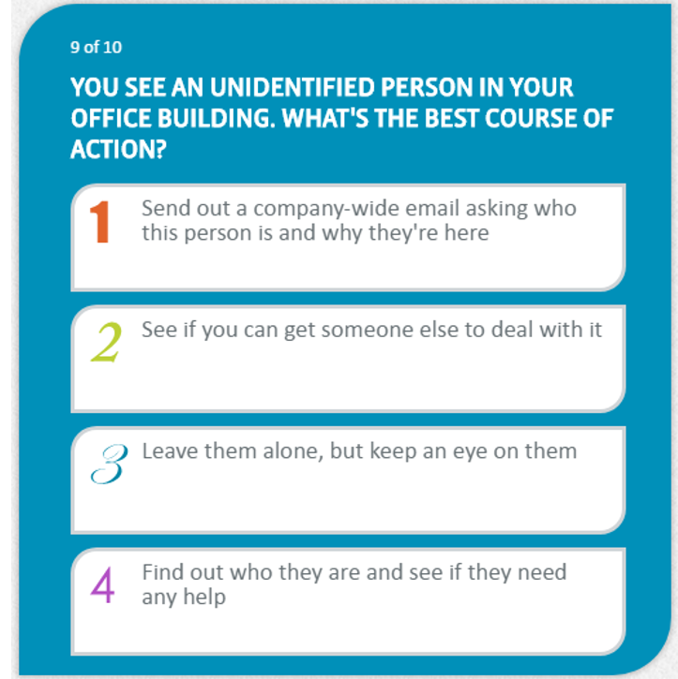
Notes:
Suzanne – SAT example

Slide 25
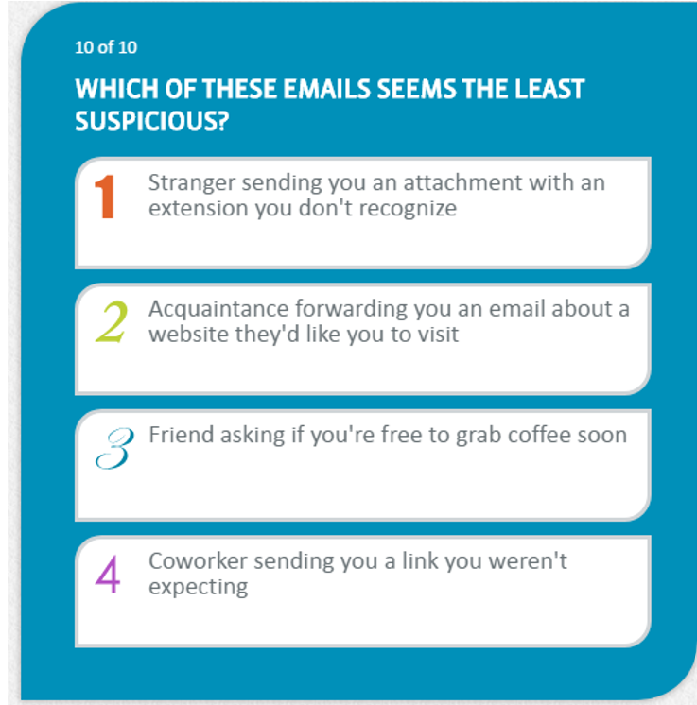
Notes:
Suzanne – SAT example

Slide 26
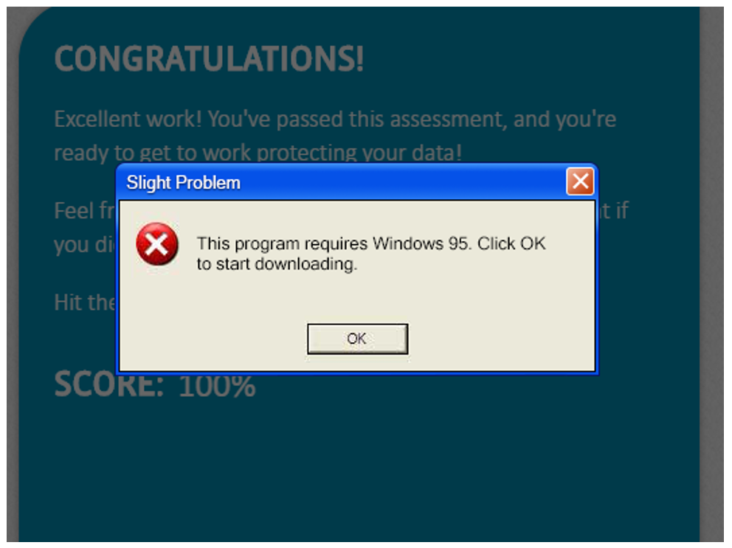
Notes:
Suzanne – SAT example – pop up

Slide 27
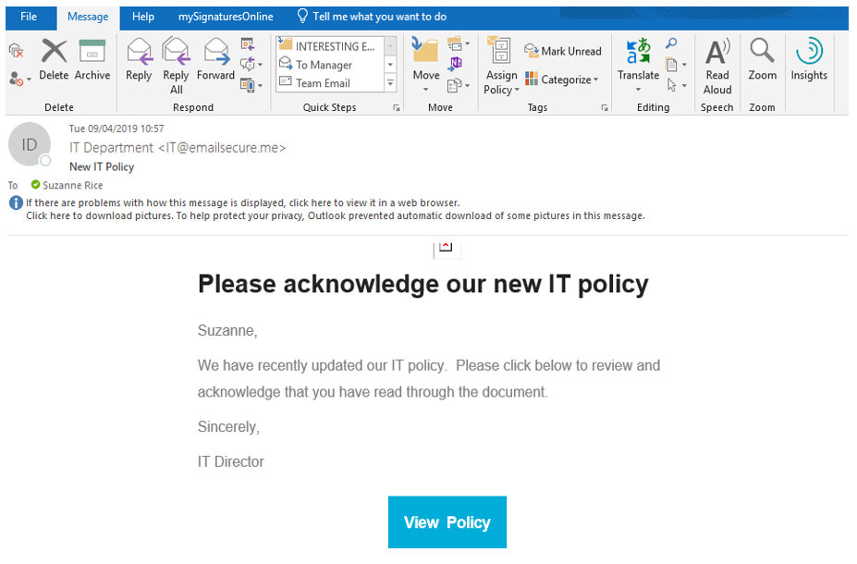
Notes:
Steve
Tailored phishing tests

Slide 28
THANK YOU
Questions?

Slide 29
Steve and Suzanne Rice
Computer Troubleshooters
01732 300064
support@ct-tonbridge.co.uk
www.computertroubleshooters.co.uk/tonbridge

