Slide 1
TIPS TO GET YOUR BUSINESS STARTED ON ITS SUSTAINABILITY JOURNEY.
By Jade Pluck

Slide 2
Company Purpose – The WHY your company exists
“To create a better everyday life for the many people.”
“Our vision also goes beyond home furnishing. We want to create a better everyday for all people impacted by our business.”
https://ikea.jobs.cz/en/vision-culture-and-values/

Slide 3
Company Values – Creating a culture for people to thrive
“Caring for the people and the planet.
We want to be a force for positive change. We have the possibility to make a significant and lasting impact - today and for the generations to come.”
https://ikea.jobs.cz/en/vision-culture-and-values/

Slide 4
Forbes Article
Global Study Reveals Consumers Are Four To Six Times More Likely To Purchase, Protect And Champion Purpose-Driven Companies
“92% of Gen-Z (Age 6-24) and 90% Millennial (Age 25-40) respondents said they would act in support of a purposeful brand;”
https://www.forbes.com/sites/afdhelaziz/2020/06/17/global-study-reveals-consumers-are-four-to-six-times-more-likely-to-purchase-protect-and-champion-purpose-driven-companies/?sh=714e1b01435f

Slide 5
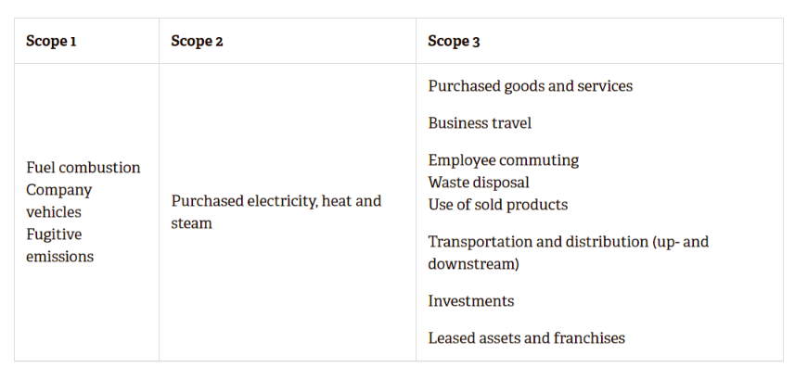
Calculate Your Emissions - Carbon Trust
https://www.carbontrust.com/resources/briefing-what-are-scope-3-emissions

Slide 6
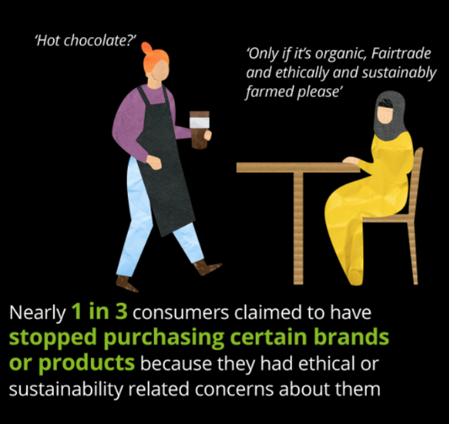
Deloitte Study
“Shifting sands: Are consumers still embracing sustainability? Changes and key findings in sustainability and consumer behavior in 2021”
https://www2.deloitte.com/uk/en/pages/consumer-business/articles/sustainable-consumer.html

Slide 7
Sustainability Tips
Use Zellar or the GHG Protocol to calculate your carbon emissions.
Pledge your reduction of carbon emissions on the SME Climate Hub.
Create a sustainability report to share with your stakeholders.
Identifying future business opportunities
Strengthen your stakeholder relationships
Building long term resilience
Link your sustainability goals to the UN Sustainable Development Goals.

Slide 8
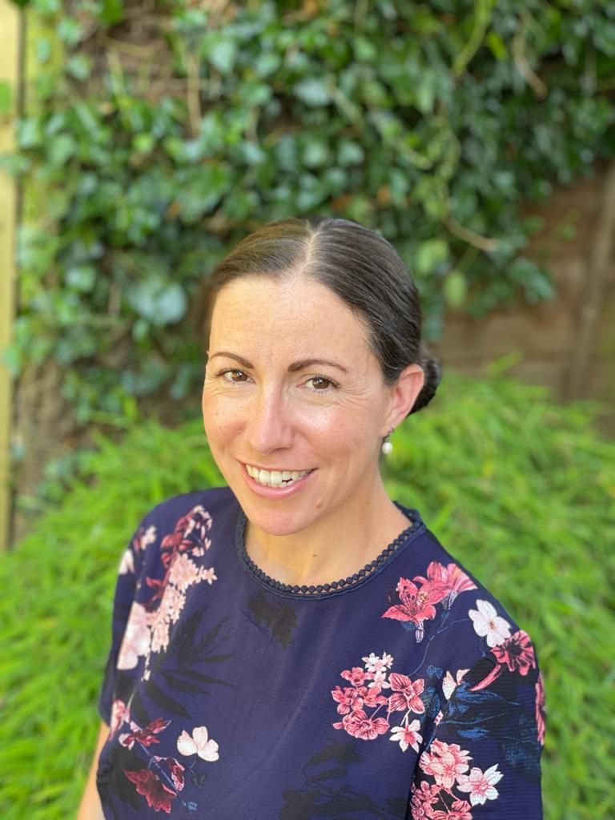
Multiple small sustainable steps make a big difference.
Email: jade@jadeconsultancy.co.uk
Tel: 07834 525624
Connect with me on LinkedIn: linkedin.com/in/jadepluck
Follow Jade Consultancy on LinkedIn: https://www.linkedin.com/company/jadeconsultancy
Website: www.jadeconsultancy.co.uk

