Slide 1
Citizens Advice in North & West Kent
Helen Beckerson
Fundraising Manager
Citizens Advice in North & West Kent
Helen.Beckerson@nwkent.cab.org.uk

Slide 2
What we do
We give people the knowledge and confidence they need to find their way forward – whoever they are and whatever their problem.
Notes:
We can all face problems that seem complicated or intimidating. At Citizens Advice, we believe no one should have to face these problems without good quality, independent free advice.

Slide 3
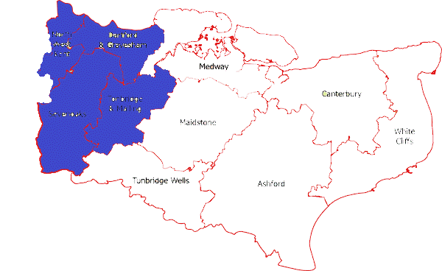
Citizens Advice in North and West Kent
Sevenoaks & Swanley
Tonbridge & Malling
Gravesham
Dartford
Notes:
We are an independent charity affiliated to the national Citizens Advice network.
We cover a fairly wide geographical area which includes 4 local authorities – Tonbridge & Malling, Gravesham, Dartford and Sevenoaks
Our service is for everyone, but we try to ensure we’re accessible to the most vulnerable in our community.

Slide 4
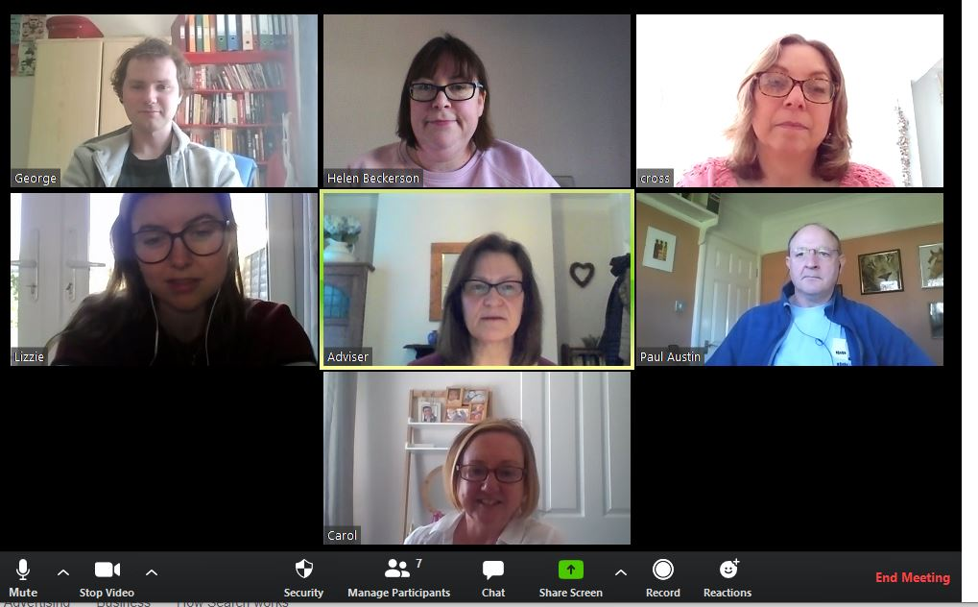
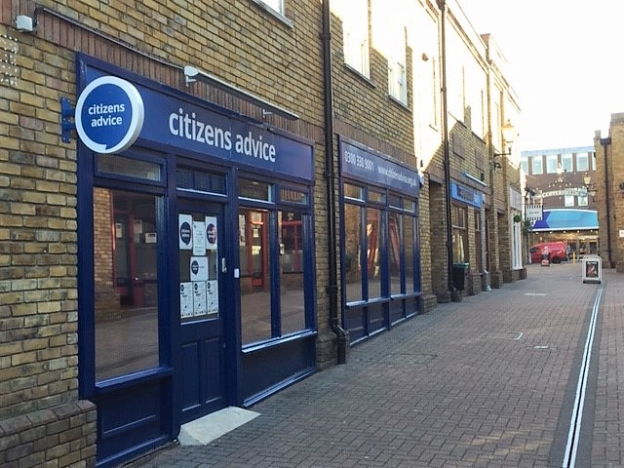
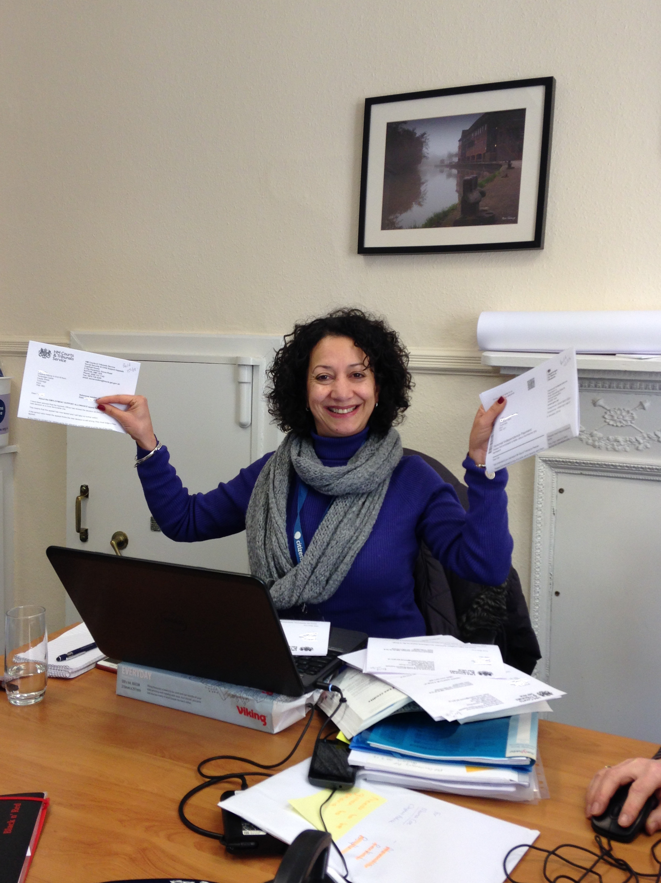
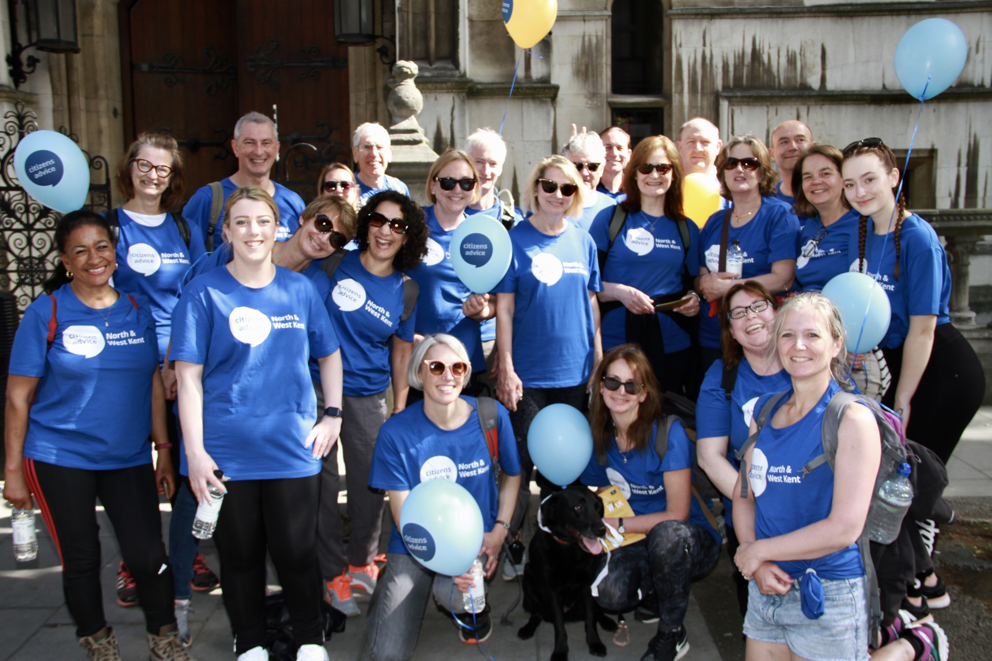
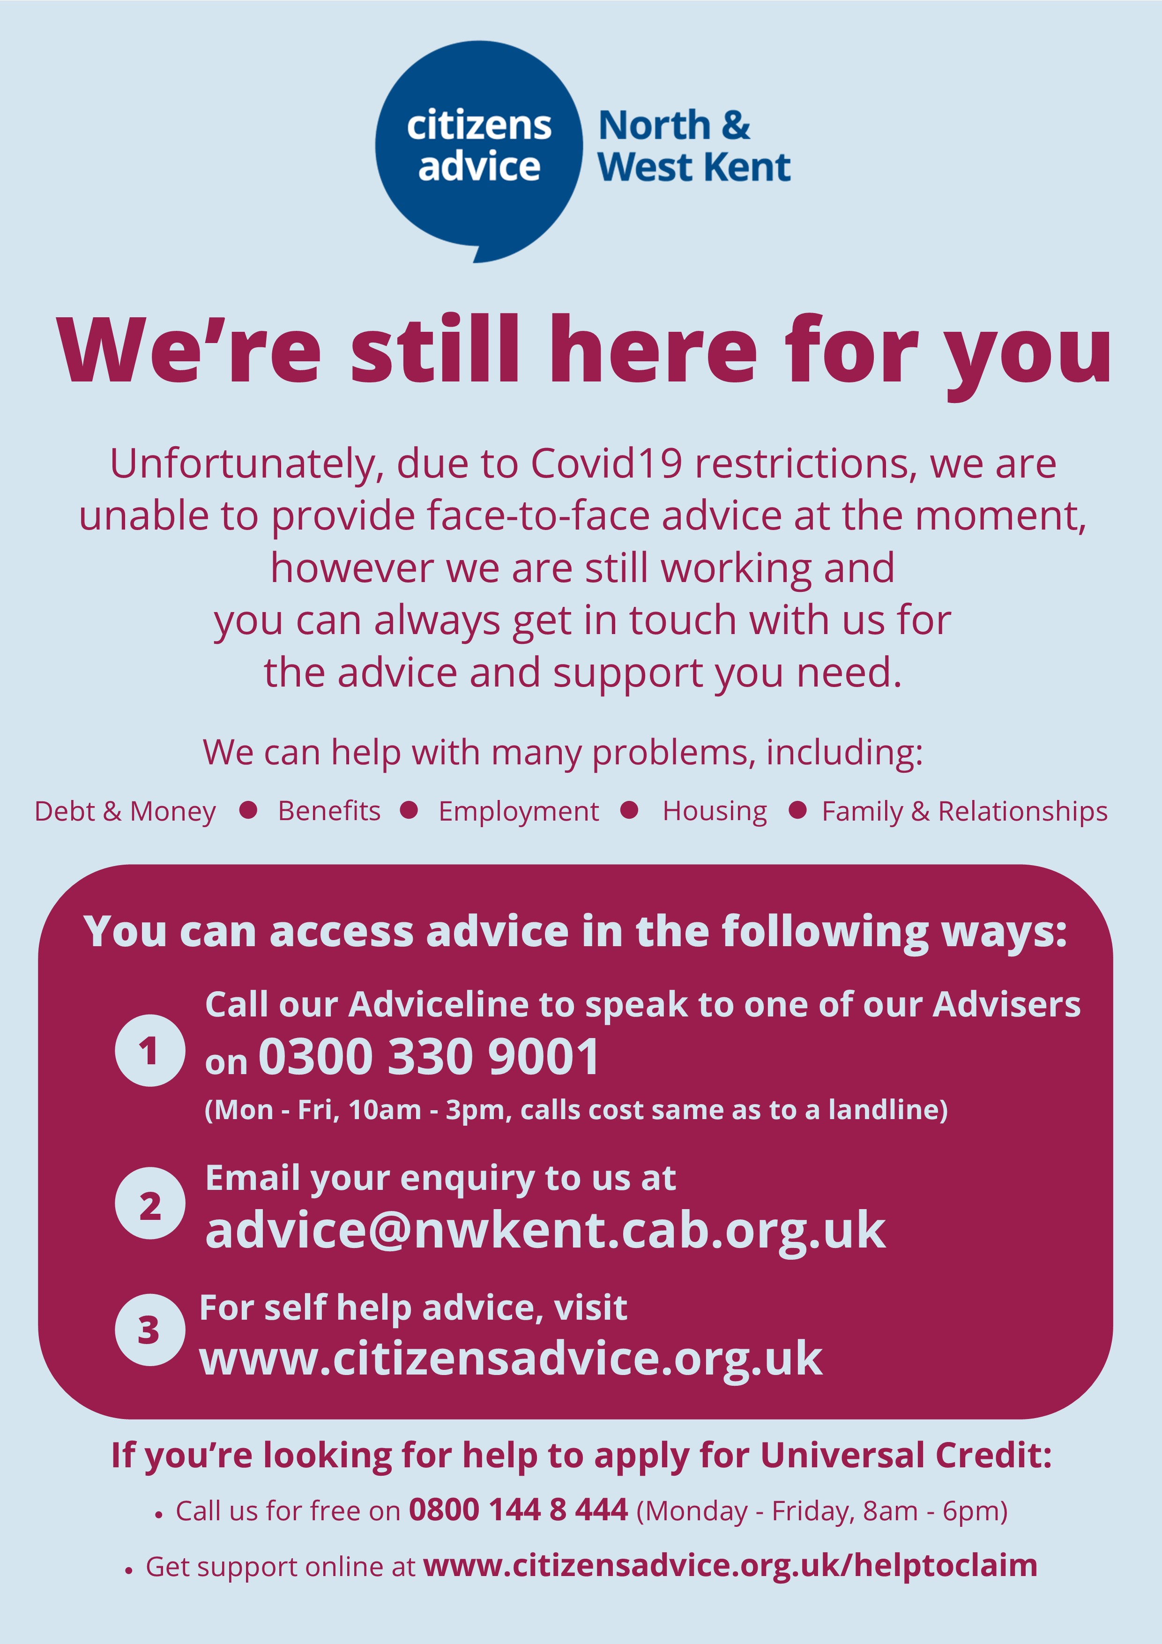
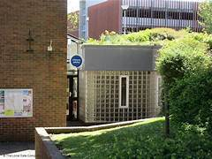
Then
Now
FREE
Notes:
Across North and West Kent
At the beginning of March, we had 5 Advice Centres in busy public locations across North and West Kent, with 50% face-to-face. We had 160 volunteers and around 60 (mostly part time) staff working within these centres
Still here
Delivering remote advice
Since the start of lockdown, we have helped over 1,300 people in Sevenoaks

Slide 5
Impact of Covid-19: Testing the Citizens Advice Model
Consistently high demand for advice
Skilled & experienced volunteers
No face-to-face advice
Notes:
Covid-19 has had the potential to strike at the heart of the Citizens Advice model of service delivery.
Almost overnight the demand rose as people were looking for answers amongst the confusion mass of complex information. Each time there was a government announcement there would be another spoke in demand. As you would expect, majority of advice issues have been for benefits and employment issues, along with relationship and family problems, housing and immigration. Debt advice almost disappeared for awhile and is only now beginning to rise – without the threat of creditor action the pressure was off.
We have always relied on our volunteers who support us with a huge range of skills and experience. Our volunteer numbers shrank dramatically at beginning – shielding, caring responsibilities, home schooling and simply having other priorities of focus on. More volunteers have been coming back, but many still not able

Slide 6
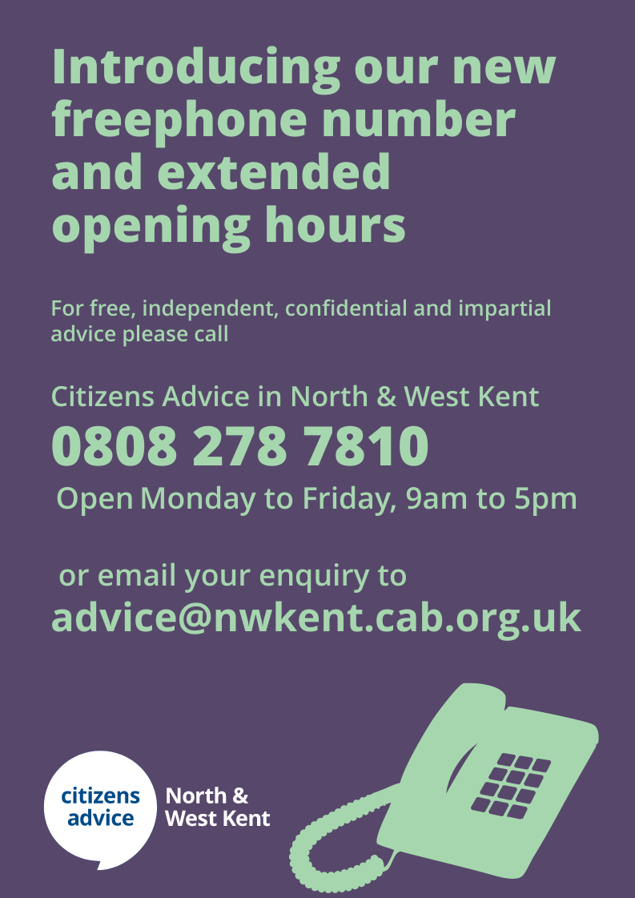
How we have tackled the challenges
We have focussed on reaching the most vulnerable in our community
Increased advice giving capacity
Freephone Adviceline with extended hours
Marketing our service like never before
Notes:
Increased advice capacity:
Fortunately many local and national funders have stepped up with short term emergency funding, and we’ve been able to access some
We have been employing paid staff for both generalist and specialist advice.
This approach has been an enormous success – we are able to answer those first contacts, tailor the depth of advice to the clients needs and ensure that those who need specialist help can access it.
We were averaging 30% call answering before lockdown, now up to 60%+
Throughout this period, we have continually asked ourselves if we are successfully reaching the most vulnerable on our community. Some of the measures we’ve put in place have been:
Took opportunity to be in first wave of freephone rollout from National Citizens Advice, so cost will not longer to a barrier to our telephone advice. Our extended opening hours also mean that it is easier for people to find a convenient time to contact us.
Marketing our services widely to reach out to those not used to accessing our services. Using social media, local community website and partner agencies, we have focused on increasing awareness of our advice services. With the support of local foodbanks and community volunteer schemes, vulnerable residents have received CANWK leaflets (with contact information and key advice messages) with their food parcels.

Slide 7
How we help local people
Benefits – all benefits including help to claim Universal Credit
Debt and money management issues – problems with debts, difficulty budgeting and managing on low income
Housing issues
Employment
Relationship problems and family law
Immigration
Notes:
As I’ve said, we can give advice to anyone with any problem. If we are not the best ones to help, we will advise clients how to get the help or support they need. This might be in giving them information about other services available, including statutory services and other voluntary sector organisations, or by making direct referrals on the clients behalf.
However these are the most common advice areas where we tend to support local people.
We have specialists that support generalists

Slide 8
How to contact us for advice during Covid-19
Call us: Freephone 0808 278 7810
Available Monday-Friday, 9am-5pm
Email: advice@nwkent.cab.org.uk
Visit www.citizensadvice.org.uk

Slide 9
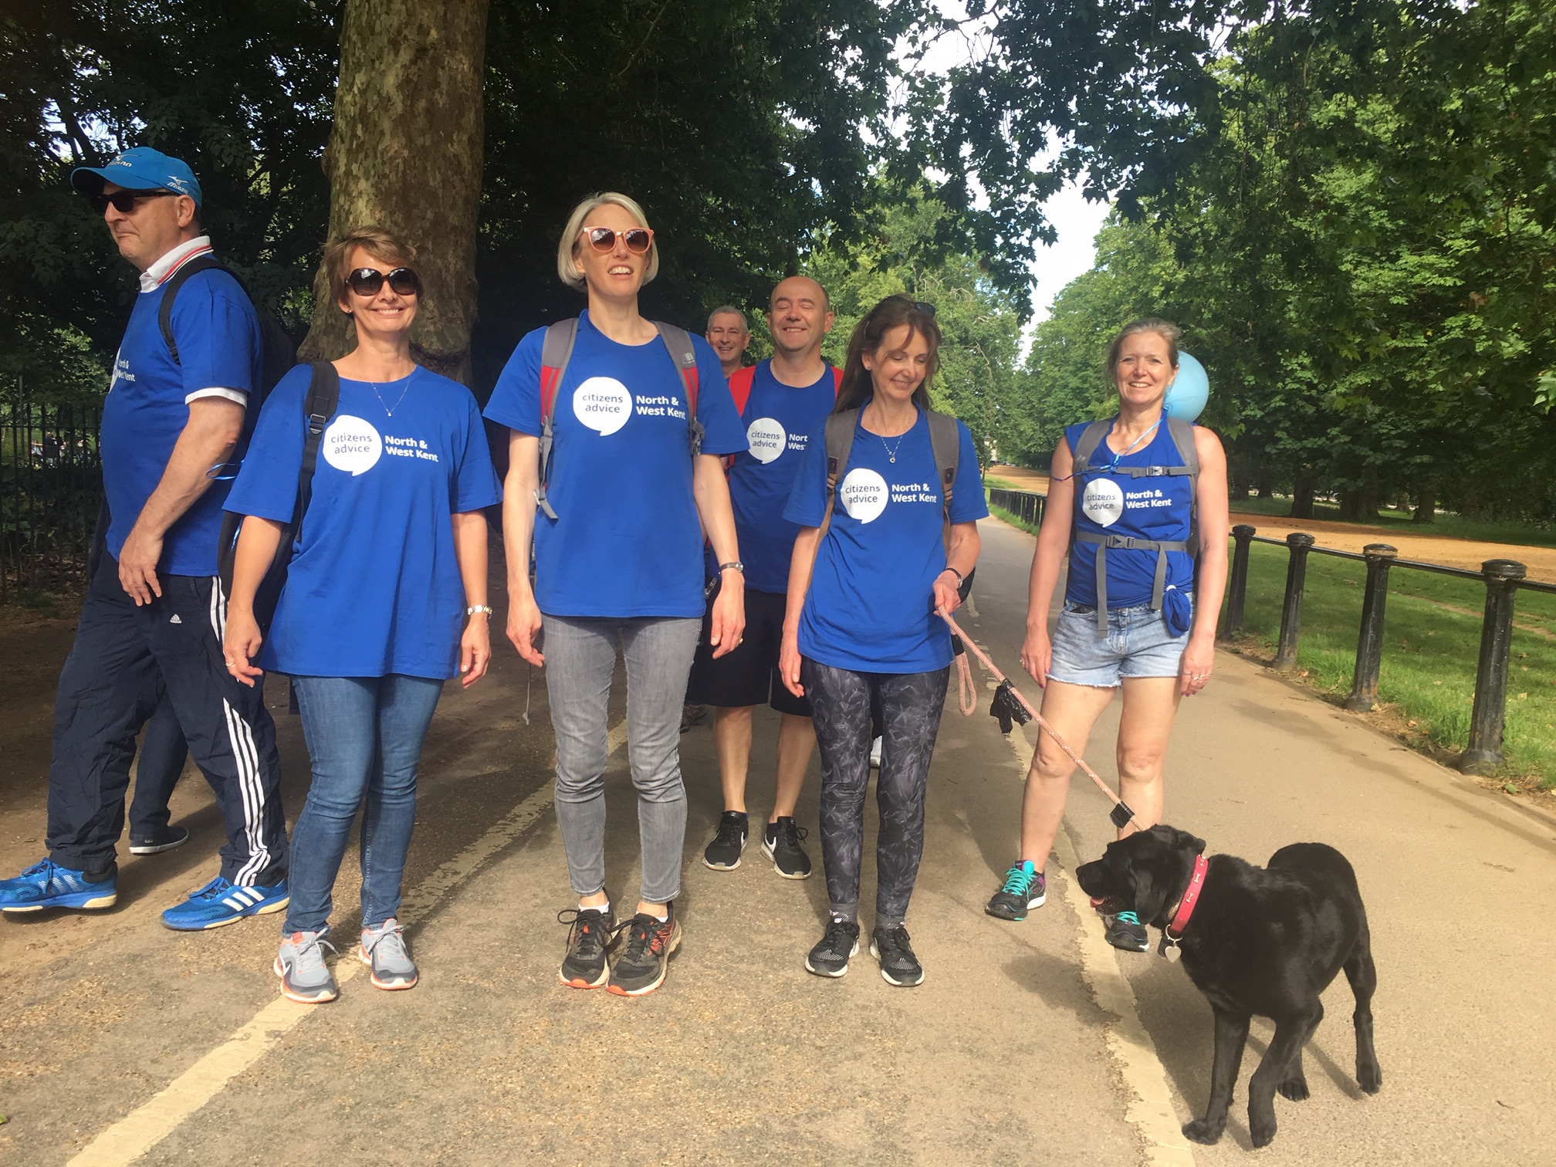
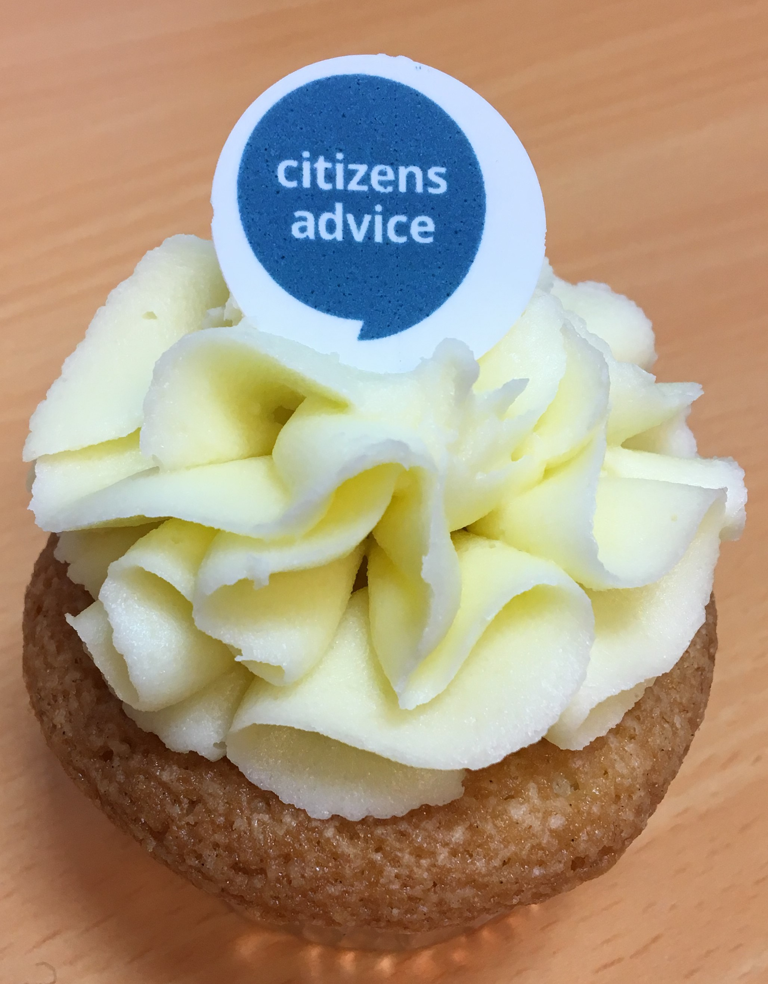
If you’d like to support us
Fundraising:
Charity of the Year
Office fundraising
Join our virtual fundraising walk/runs
To enter please register for free at https://santainthecity.co.uk/ choose Citizens Advice in North & West Kent from the dropdown menu. Come and join us CANWK’s SANTAS.
Notes:
We’re recruiting Santas for our Santa Run. You can take part any day in December or join our CANWK Santa Run on Monday 14 December. To enter please register for free at https://santainthecity.co.uk/ choose Citizens Advice in North & West Kent from the dropdown menu. There is a choice to join a team. Come and join us CANWK’s SANTAS.

