Slide 1



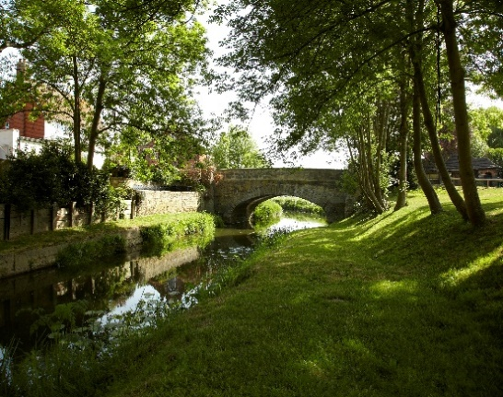
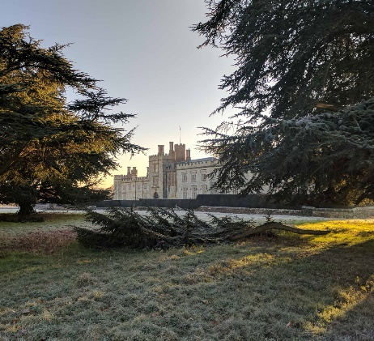

Supporting Business
Emily Haswell – Economic Development

Slide 2
Supporting Your Business
Introduction and background
Meeting Point – Swanley
West Kent Business Support Programme
Green Business Grants Scheme
More Sevenoaks – Business Directory
business@sevenoaks.gov.uk

Slide 3


New business co-working hub opening in May
Private offices
Fixed desks
Hot desking
Meeting Room
Lounge area with break out tables and relaxed seating
Event Space
Business support package included
Shared outside area

Slide 4
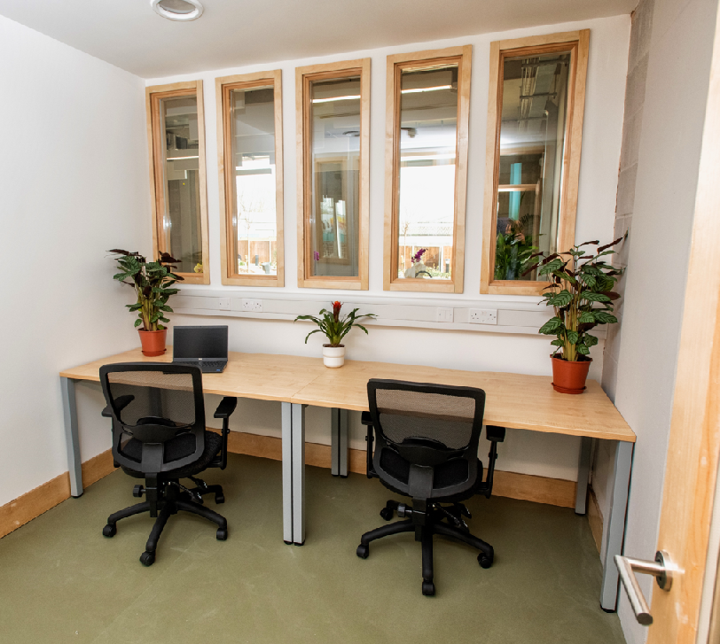
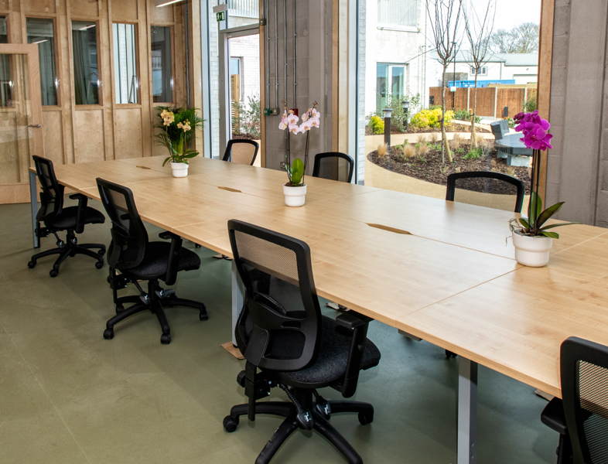
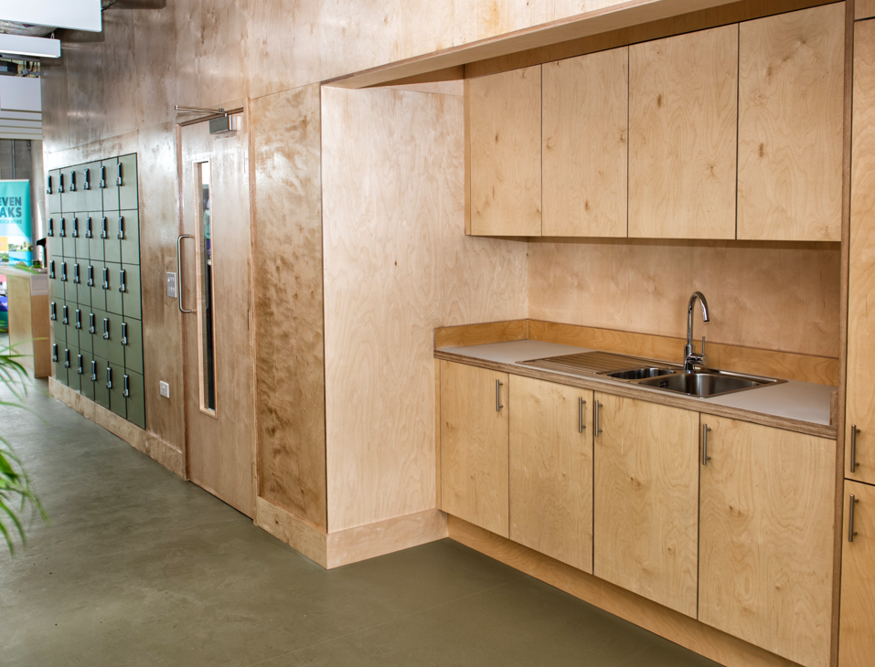

Slide 5
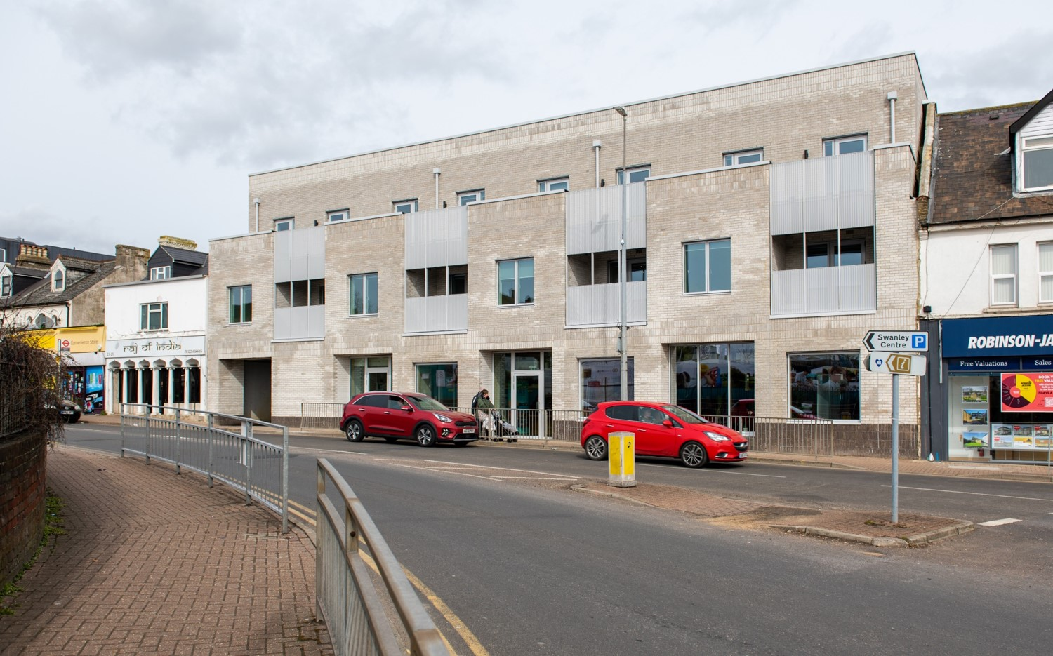
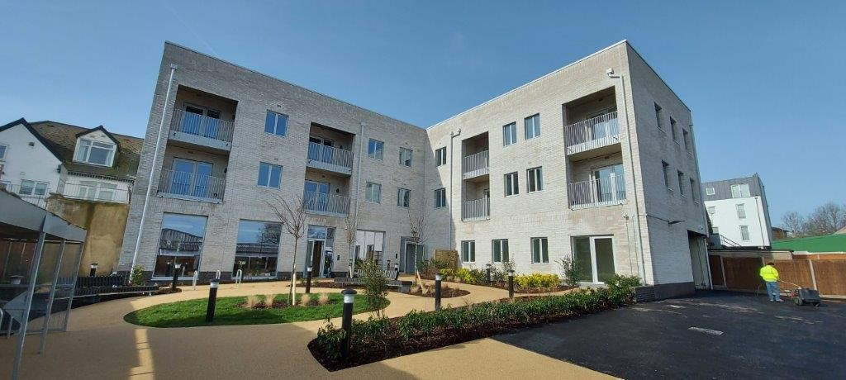
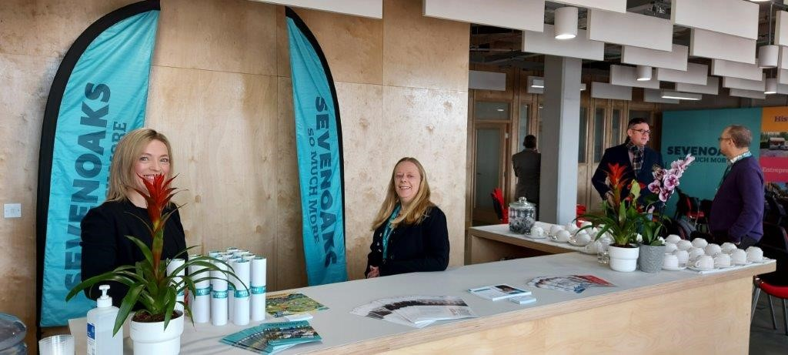
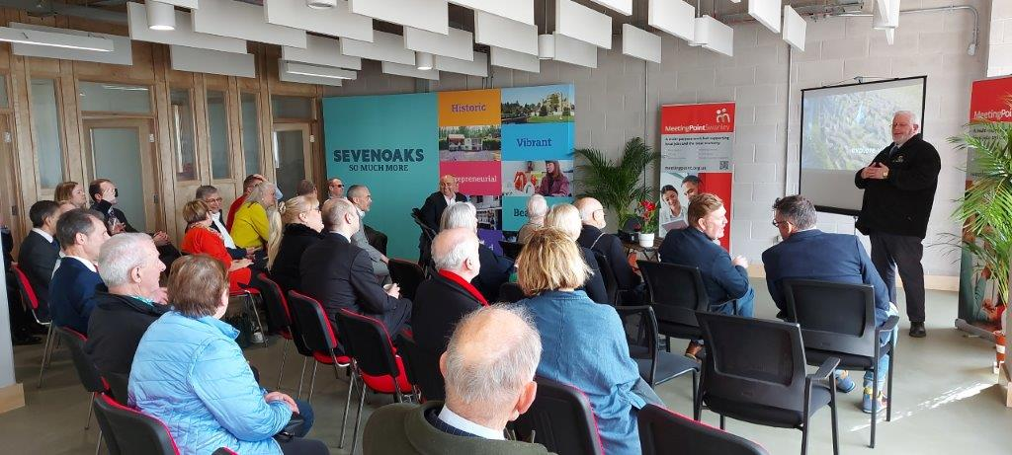

Slide 6


Slide 7



West Kent Business Support Programme
Business Support for West Kent Businesses
Free business support programme for all West Kent businesses delivered by Smarter Society on behalf of West Kent Partnership as part of UK Governments Shared Prosperity fund
https://westkentbusiness.com/ - Register here for scheme
Launch of West Kent Business Tickets, Thu 11 May 2023 at 12:30 | Eventbrite

Slide 8
Mentoring
  1-2-1 support delivered by experts in growth, digital, funding applications and general support
Training & Networking
  Hybrid format events across the West Kent Area
  Networking sessions at local co-working spaces to foster new partnerships
Annual Festival of Business
  Large event showcasing West Kent businesses and entrepreneurs
West Kent business online portal
  Training sessions recorded and hosted online
  Register for events, mentoring and support
  Business support helpline

Slide 9
Green Business Grant Scheme
Funded through UK Governments Shared Prosperity fund as part of levelling up agenda
Partnership working Sevenoaks District Council with Tonbridge and Malling Borough Council
Capital Grants to help reduce businesses carbon footprint
Application open 18 April 2023 – 31 May 2023
Additional round possible in 2024 not guaranteed
https://www.sevenoaks.gov.uk/business

Slide 10
Section A grants – Low Carbon Sector
For businesses in Low Carbon and renewable energy economy (LCREE) sector
Up to £8000 to fund 40% of business development initiatives
Majority of operation must fall within one of 17 LCREE sectors
Plans must fit within one or more of: Research and Development, Physical infrastructure, Equipment and machinery
Or make compelling case to detail how your proposal meets the aims of the scheme

Slide 11
Section B Grants - For low carbon improvements
For businesses in any sector taking measures to to reduce carbon footprint
Up to £5000 to fund 40% of the costs of reducing carbon footprint of commercial premises
Priority given to those in; Food Production, Tourism and Hospitality, Distribution and Logistics, Construction, Independent retail

Slide 12
Conditions:
Grants subject to securing all necessary permissions
No retrospective grants - will not support works already been undertaken or started before formal offer made
Can only apply for A or B not both
Must be located within SDC, or TMBC and have a commercial premises
Full details on guidance notes

Slide 13
How to apply
Link directs to TMBC application form - this is correct!
SDC will be completing assessment and allocating funding for all Sevenoaks applications
Read guidance notes before applying
https://www.sevenoaks.gov.uk/downloads/download/956/green_business_grant_guidance_2023
Any Queries: business.grants@sevenoaks.gov.uk

Slide 14

More Sevenoaks – Promoting Place
Live
Work
Invest
Visit
FREE BUSINESS DIRECTORY
https://www.moresevenoaks.co.uk

Slide 15
Coming soon…
West Kent Rural Business Grants
Funded by Rural England Prosperity Fund
Capital funding for businesses or community organisations in rural areas
Up to £25k capital grants
Suggested 50% grant intervention rate
Rural areas cover majority of District
Contact business@sevenoaks.gov.uk to be added to list for further information when available

Slide 16
Supporting Business
Emily Haswell
Economic Development Officer
Business Support /Town Centres and UKSPF/REPF lead
Contact: emily.haswell@sevenoaks.gov.uk

